Slide 1

python
with the Ursina 3D Engine
Notes:
Helpful guide to ursina: https://www.ursinaengine.org/cheat_sheet_dark.html
Github link to all source files: https://github.com/CCC-CS-github/ursina_ks3

Slide 2
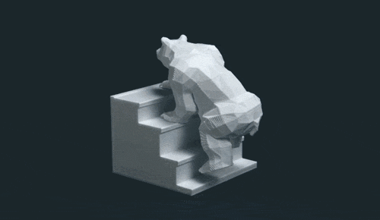
Python Coding
with Ursina
Course Stage: Hello World!
You will learn: -
i) What python is, what 'modules' are, and whether python is important in the computing world today
ii) How to set up a project folder for your python code with Ursina
iii) How to code moving 3D objects with textures, how to set colours, and to print text on screen

Slide 3
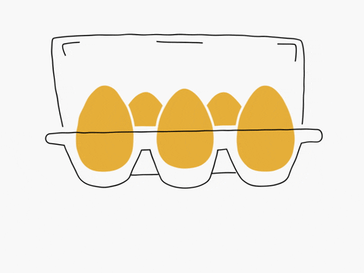

What is python?
Who invented it?
Is it popular?
Any examples of where it has been used?

Slide 4
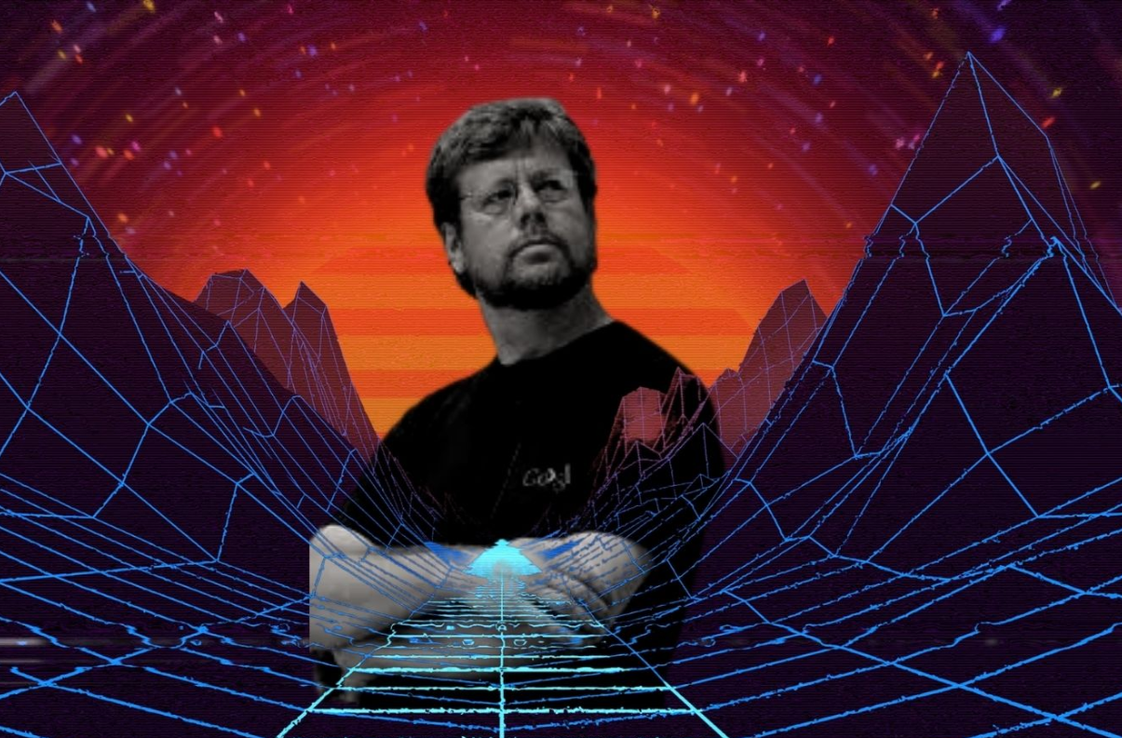
What is python?
Guido van Rossum
Yes, very!
Google, Instagram, Netflix, Data Science, Machine Learning...
Notes:
https://learn.onemonth.com/10-famous-websites-built-using-python/

Slide 5
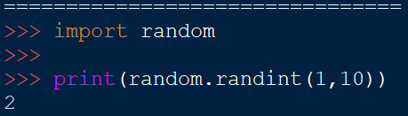
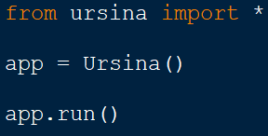
Python uses modules
You can import modules at the top of your python code.
Different modules allow you to use different functions.
The time module (time.py) allows you to find the date, time events to the millisecond, and, of course, to get the time of day.
The random module (random.py) allows you to get random numbers.
The ursina module (ursina.py) allows you to…?
Notes:
https://docs.python.org/3/tutorial/modules.html

Slide 6
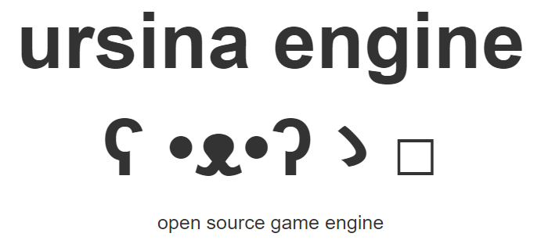
Notes:
https://www.youtube.com/watch?v=j71j88oCTNo

Slide 7
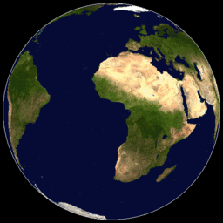
hello world!
It is a tradition when learning something new in programming (and especially a new programming language) to print 'Hello World!' to the screen. But let's go one step further...
Let's make a 3D, rotating world :) So, what will we basically need to do to make our 3D (hello!) world?
Discuss ideas with a partner, then let's see how well you've decomposed the steps in this programming goal.
Suggested steps:
Set up a window and get Ursina running
Create a 3D sphere
Put a texture on the sphere
Keep updating the sphere's rotation
Make a dark background, like space?
Notes:
Suggested steps: Set up window/Ursina -> create a cube -> texture the cube -> keep updating the cube's rotation -> make dark background?

Slide 8
project setup and assets
1 Create a new folder on your desktop called 'ursina projects'
2 Open IDLE
3 Create a new file called hello.py and save it in your new folder
4 Find a planet texture; also save it into your new ursina folder
Hello World!
Notes:
All students' python files to be kept here ('ursina projects' folder on H:drive)
NB. at time of writing (Nov 2021) -- IDLE will only find ursina module if students' python code is run from their C:Drive, e.g. from the desktop. So, students must copy their folder over to the H:drive to save their work at end of lesson.

Slide 9
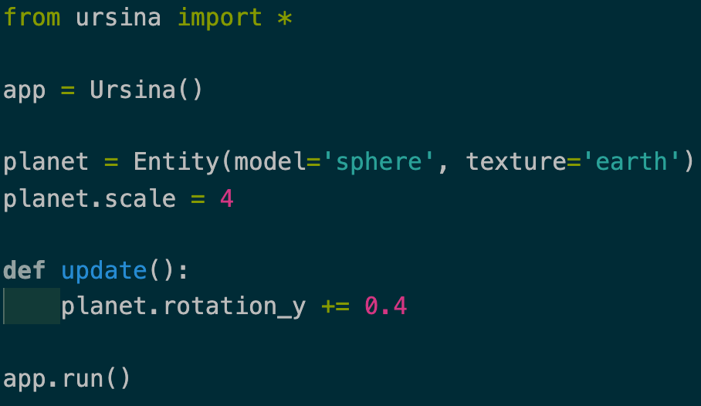
Here is our first python code. Just 7 lines :)
You must save your .py file before you can run it. Make sure your planet texture, in your folder, is named 'earth'.
Notes:
Copy the following lines.

Slide 10

Code Challenges!
1 Can you change the rotation speed of your planet?
2 Can you make your planet change scale (get bigger or smaller) as it updates?
3 Can you add a small moon -- with its own texture?
Notes:
Copy the following lines.

Slide 11
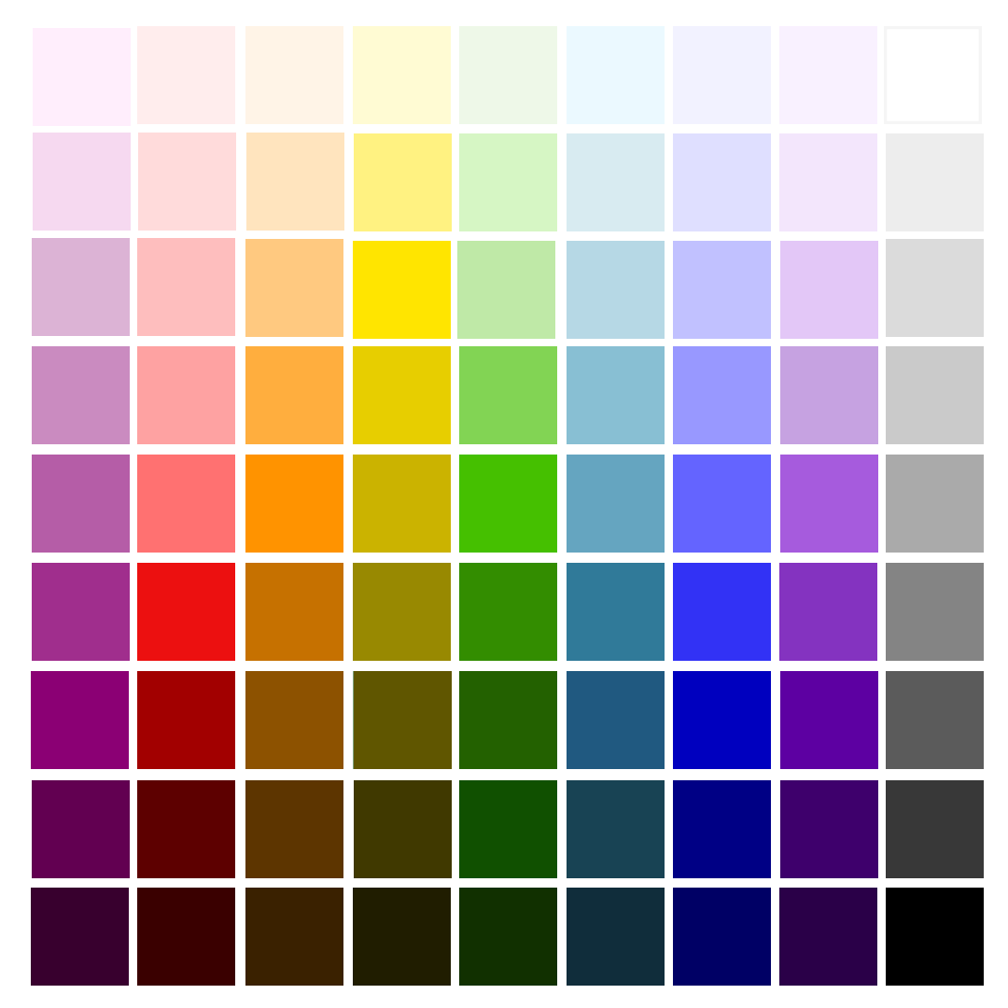
Changing the window's background colour
window.color = color.black
or
window.color = color.rgb(0,0,0)
or
window.color = color.rgb(255,0,255)
# (shhh because pink)
Notes:
NB American spelling.

Slide 12
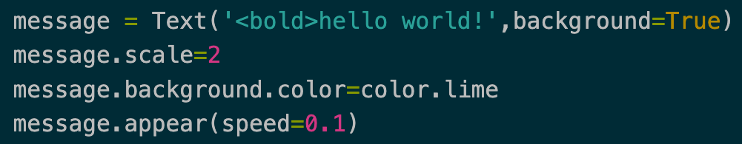
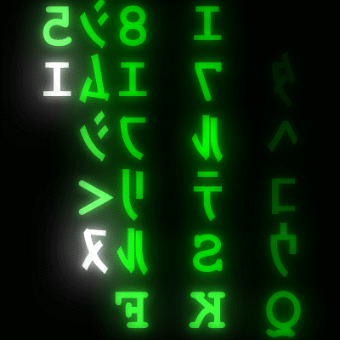
We can print text to the screen :)
First, print 'hello world!' to the screen.
Next, print whatever message you like.
Can you change the appearance of your text and its background? Can you make a transparent background?
Notes:
NB transparency with color.rgba(200, 100, 255, 202)
NB text style can be changed with <tags>

Slide 13
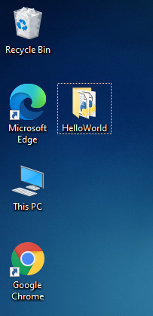
During our python lessons, we must copy our project folder onto the desktop.
This is because some of the python code won’t run if we leave them on the H:drive.
So: when working on a python project, first copy the project folder to your desktop.
ON DESKTOP

Slide 14
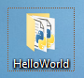
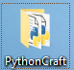
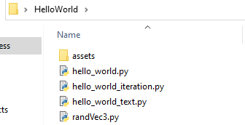
For each project, make a separate folder.
Keep all files used with a project in that project’s folder.
At the end of every lesson, copy your project folder(s) to your H:drive to save safely.

Slide 15
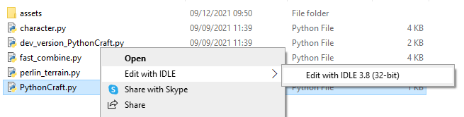
Right click a python module and select Edit with IDLE
How to open a python file to add code and run.

Slide 16
At the end of the lesson, to save this project, copy it back onto the H:drive.
If you do not copy your project onto your H:drive at the end of the lesson, your project folder will likely be automatically deleted!
H:DRIVE

Slide 17
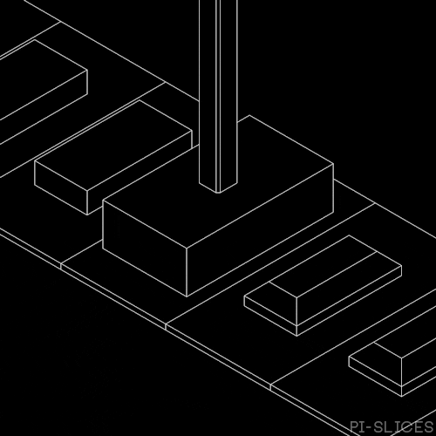
Python Coding
with Ursina
Course Stage: Hello World! 2.0
You will learn: -
i) How to use lists and iteration to create lots of objects easily
Notes:
Extension of 'Hello World!' course stage. NB iteration will be picked up in next course stage, in case too early for it here.

Slide 18
# Code 1
p = Entity(model='cube',texture='earth')
p = Entity(model='cube',texture='earth')
p = Entity(model='cube',texture='earth')
p = Entity(model='cube',texture='earth')
p = Entity(model='cube',texture='earth')
p = Entity(model='cube',texture='earth')
p = Entity(model='cube',texture='earth')
p = Entity(model='cube',texture='earth')
p = Entity(model='cube',texture='earth')
p = Entity(model='cube',texture='earth')
p = Entity(model='cube',texture='earth')
p = Entity(model='cube',texture='earth')
p = Entity(model='cube',texture='earth')
p = Entity(model='cube',texture='earth')
# Code 2
For i in range(28):
p = Entity( model='cube',
texture='earth')
Which bit of code, code 1 or code 2, will create the most cubes?
Notes:
Making lots of entities versus using a for loop. NB use random since we don't want them appearing in the same place. This leads to idea about a variable to keep track of each iteration, so as to place entities specifically.

Slide 19
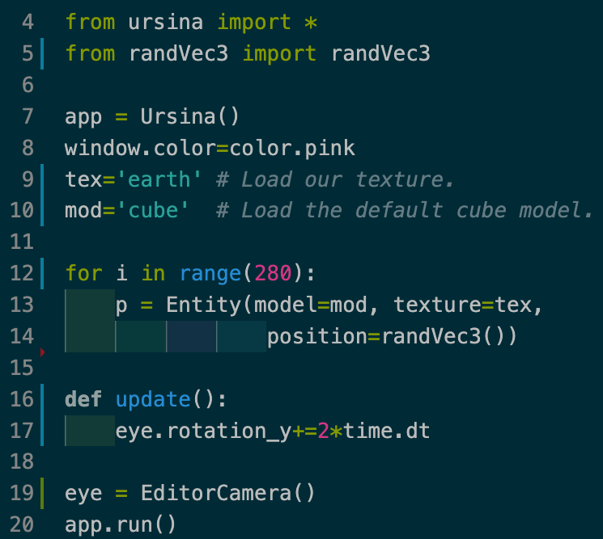
# Code 2
We can use a for loop to create hundreds...or thousands of objects :)
Notes:
Code sample 'hello_world_iteration.py' - use a loop to make even more cubes. Time to play with the index variable i (counter? Iterator?) for positioning, and perhaps nesting.

Slide 20
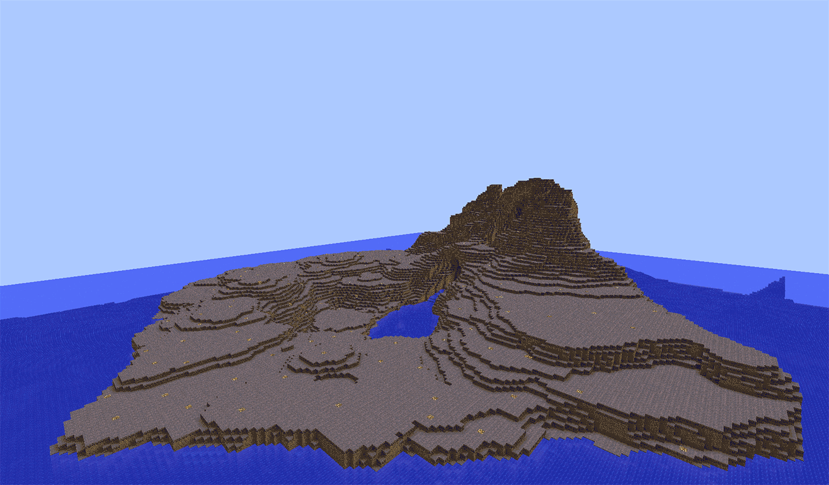
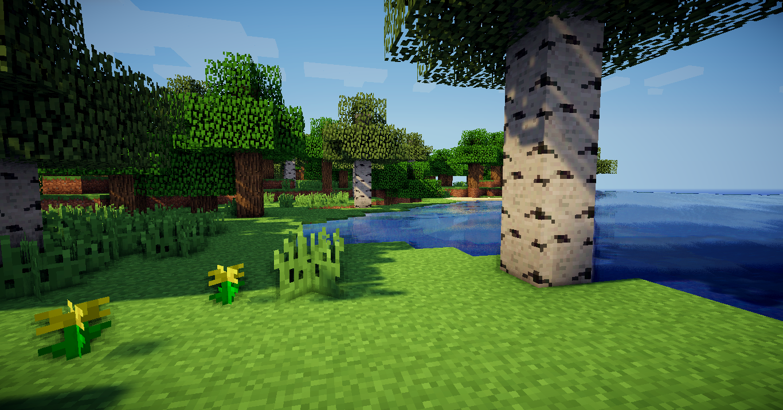
Python Coding
with Ursina
Course Stage: PythonCraft!
You will learn: -
i) What Perlin noise is and how to use it to code Minecraft-like terrains
ii) How to fix code to get a character moving across your Minecraft world
iii) How to use lists and iteration to add trees, mobs, and anything else

Slide 21

Download and place the PythonCraft project folder on your Desktop :)
Open the pythonCraft.py main module file with IDLE :D
Extension
Can you fix the code? The character doesn't seem to be able to move.
What might be the bug?
Notes:
NB. at time of writing (2021) students will have to run python from their Desktop (i.e. from their C:drive and not H:drive).

Slide 22
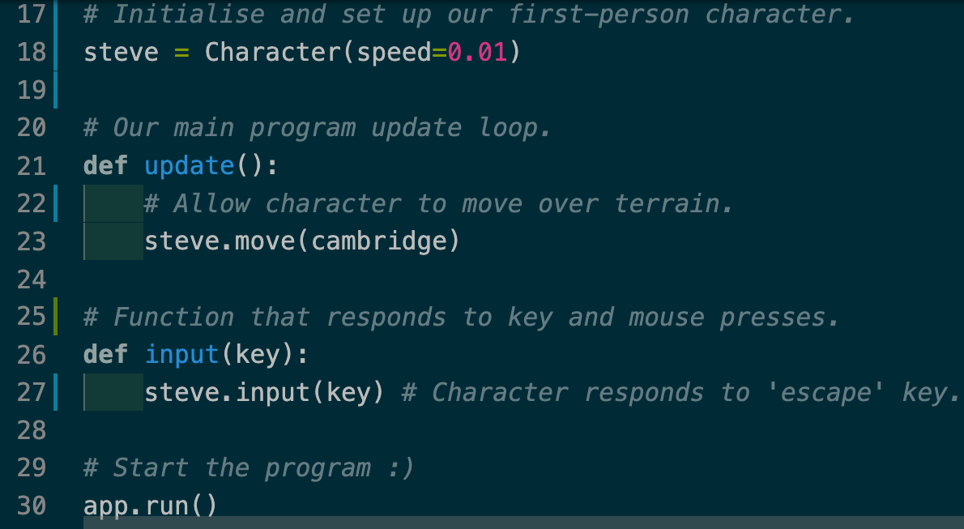
Notes:
Can we spot the bug? Solution: speed has been set to 0.01. A value like 4 is more appropriate.

Slide 23
This value is too small
Notes:
Can we spot the bug? Solution: speed has been set to 0.01. A value like 4 is more appropriate.

Slide 24
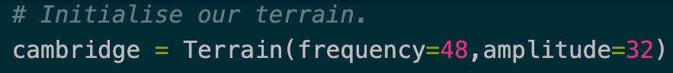
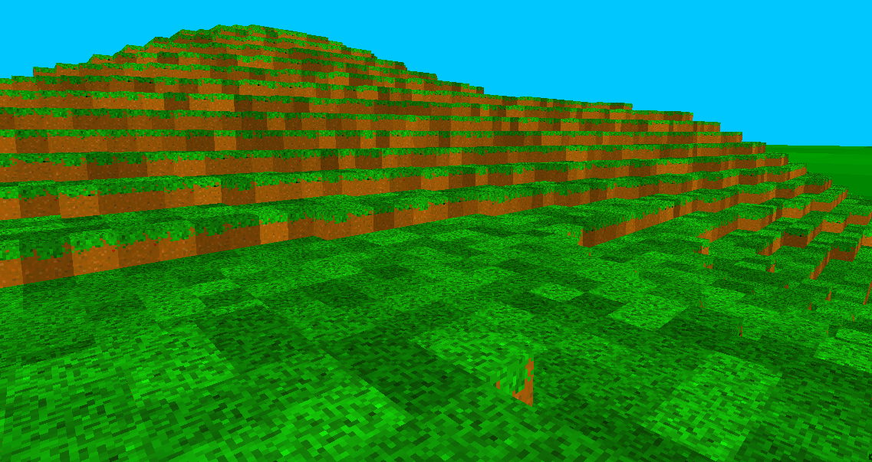
We pass in two arguments when making a Terrain() object.
It uses a 'Perlin noise' function to generate the hills and valleys of our terrain.
The amplitude value is how high or low the terrain can get.
amplitude
frequency?
Notes:
Students experiment with different values. Can they determine what the frequency value does? Can they discover any interesting combinations?

Slide 25
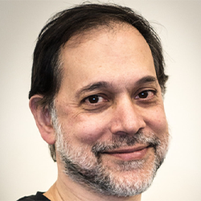

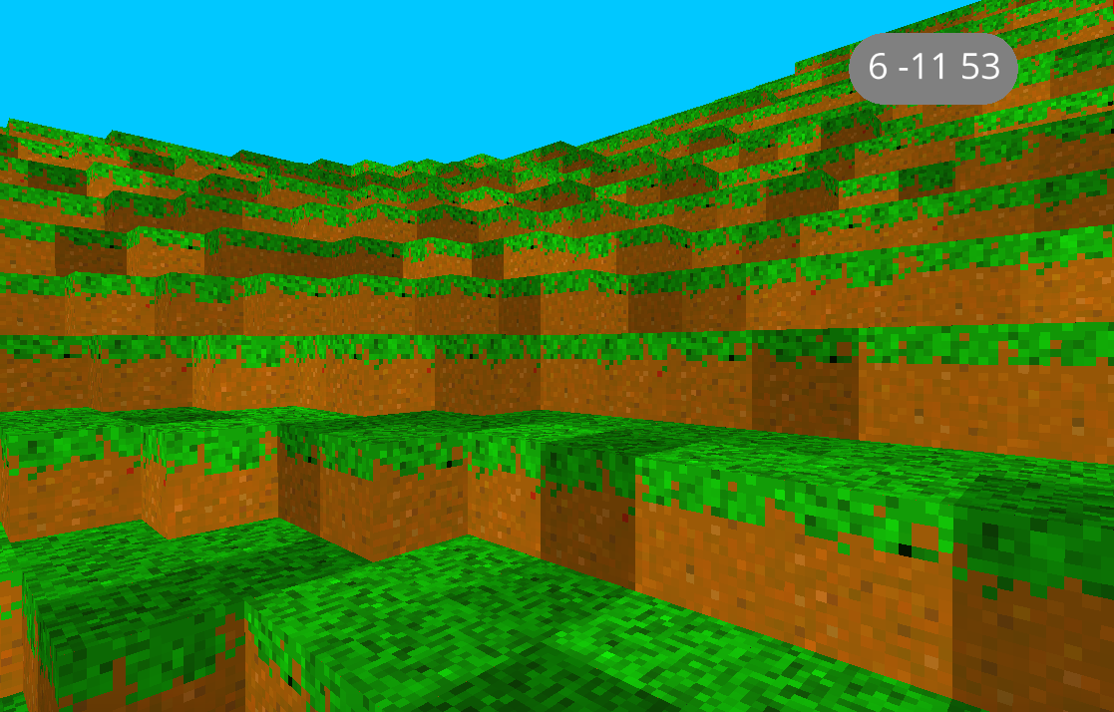
Generating Terrain with Perlin Noise
Prof. Ken Perlin
amplitude - how high/low
frequency - the smoothness of amplitude variation from one area of the terrain to the next

Slide 26
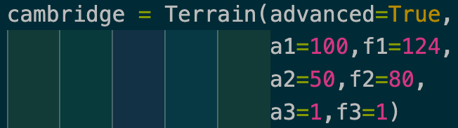
Generating Terrain with Perlin Noise
Prof. Ken Perlin
octaves
We can make more realistic and interesting terrains by passing in three amplitudes with three frequencies.

Slide 27
Create a research document or presentation
Screenshots with what amplitude and frequency - discover interesting terrains
Also -- slide/page dedicated to theory about what effects different frequencies and amplitudes have -- i.e. what is the Nature of the relationship between these?

Slide 28
Notes:
Split template - not to be used - duplicate only.

Slide 29
During our python lessons, we must copy our project folder onto the desktop.
This is because some of the python code won’t run if we leave them on the H:drive.
So: when working on a python project, first copy the project folder to your desktop.
ON DESKTOP

Slide 30
For each project, make a separate folder.
Keep all files used with a project in that project’s folder.
At the end of every lesson, copy your project folder(s) to your H:drive to save safely.

Slide 31
Right click a python module and select Edit with IDLE
How to open a python file to add code and run.

Slide 32
At the end of the lesson, to save this project, copy it back onto the H:drive.
If you do not copy your project onto your H:drive at the end of the lesson, your project folder will likely be automatically deleted!
H:DRIVE

